Slide 1
QC Coders
Intro to Virtualization

Slide 2
What is Virtualization?
In computing, virtualization refers to the act of creating a virtual (rather than actual) version of something, including virtual computer hardware platforms, storage devices, and computer network resources.
Hardware virtualization or platform virtualization refers to the creation of a virtual machine that acts like a real computer with an operating system. Software executed on these virtual machines is separated from the underlying hardware resources. For example, a computer that is running Microsoft Windows may host a virtual machine that looks like a computer with the Ubuntu Linux operating system; Ubuntu-based software can be run on the virtual machine.^{[2][3]}

Slide 3
What is Virtualization?
In hardware virtualization, the host machine is the actual machine on which the virtualization takes place, and the guest machine is the virtual machine. The words host and guest are used to distinguish the software that runs on the physical machine from the software that runs on the virtual machine. The software or firmware that creates a virtual machine on the host hardware is called a hypervisor or Virtual Machine Manager.

Slide 4
Benefits of Virtualization
Hardware Consolidation
Multiple virtualized machines can be run on the same physical machine, eliminating the need to purchase and maintain a separate physical machine for each, as was the practice prior to virtualization.
Fast, Low Cost Provisioning
A new virtual machine can be created and running in as little as a few minutes. A physical server must be specified, ordered and installed in a process that typically takes weeks.
Virtual servers are several orders of magnitude cheaper to provision than physical servers, depending on OS licensing costs.
Granular Control
Through management tools, virtual machines can be expanded and fully manipulated down to BIOS settings, all remotely.

Slide 5
Benefits of Virtualization
Snapshots
A snapshot is a state of a virtual machine, and generally its storage devices, at an exact point in time. A snapshot enables the virtual machine's state at the time of the snapshot to be restored later, effectively undoing any changes that occurred afterwards. This capability is useful as a backup technique, for example, prior to performing a risky operation.
Migration
The snapshots described above can be moved to another host machine with its own hypervisor; when the VM is temporarily stopped, snapshotted, moved, and then resumed on the new host, this is known as migration. If the older snapshots are kept in sync regularly, this operation can be quite fast, and allow the VM to provide uninterrupted service while its prior physical host is, for example, taken down for physical maintenance.

Slide 6
Benefits of Virtualization
Failover
Similarly to the migration mechanism described above, failover allows the VM to continue operations if the host fails. However, in this case, the VM continues operation from the last-known coherent state, rather than the current state, based on whatever materials the backup server was last provided with.
Auto-Scaling
In distributed computing environments (e.g. web hosting), additional copies of a virtual machine can be created, powered on and added to a resource pool automatically, expanding computing power for high demand periods.
AWS Elastic Beanstalk, Azure autoscale

Slide 7
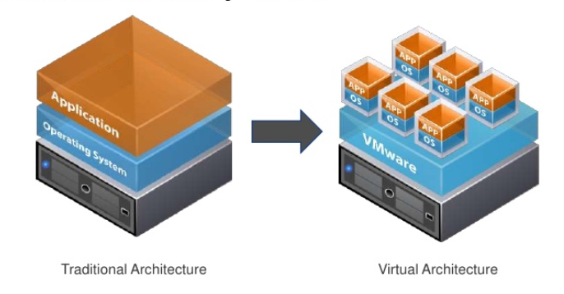
Virtualization Architecture

Slide 8
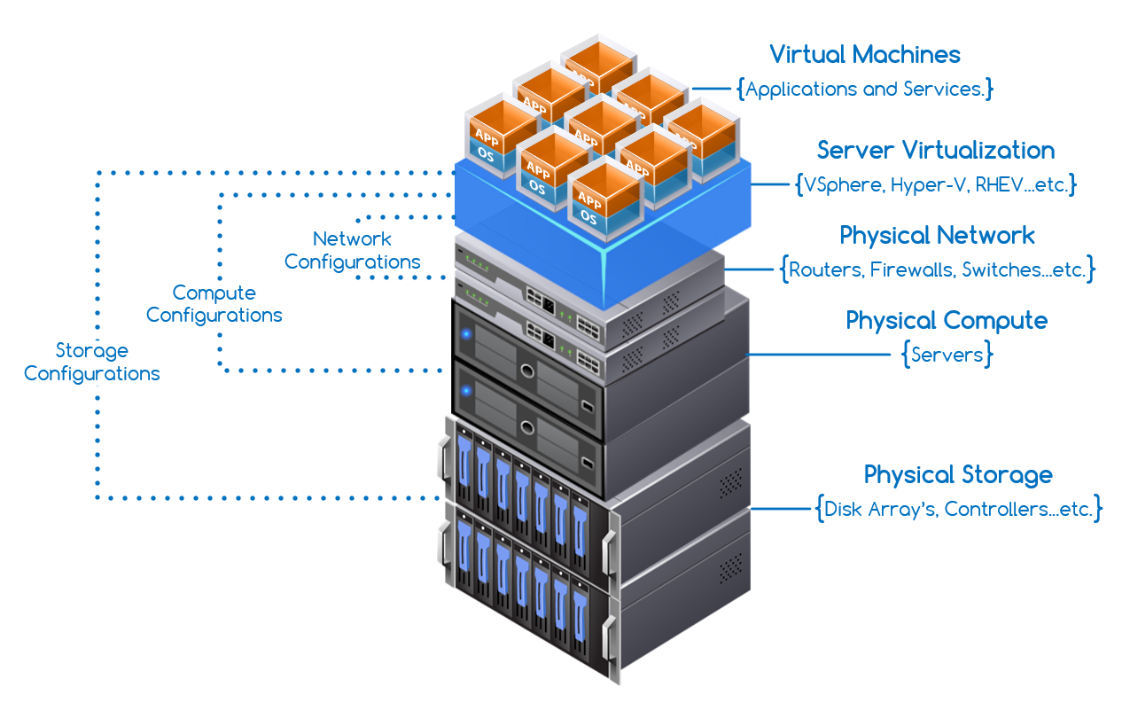
Virtualization Architecture

Slide 9
Virtualization at Home
Minimum Requirements
64 bit x86 CPU (AMD/Intel)
CPU Hardware Virtualization support
Intel VT-x
AMD RVI/V
(2005 and later, generally)
> 2GB RAM
Supported Gigabit NIC (check the Compatibility Guide)
If RAID is desired, a hardware RAID controller
LSI variants (Dell PERC, IBM ServeRAID)
Integrated (motherboard) RAID controllers will NOT work
SSD hard drive highly recommended

Slide 10
Questions?

Slide 11
Demonstration

